Slide 1


Total Energies Final Steering Committee
Master X-HEC – 23.01.2023 © Capgemini 2023. All rights reserved | 1

Slide 2
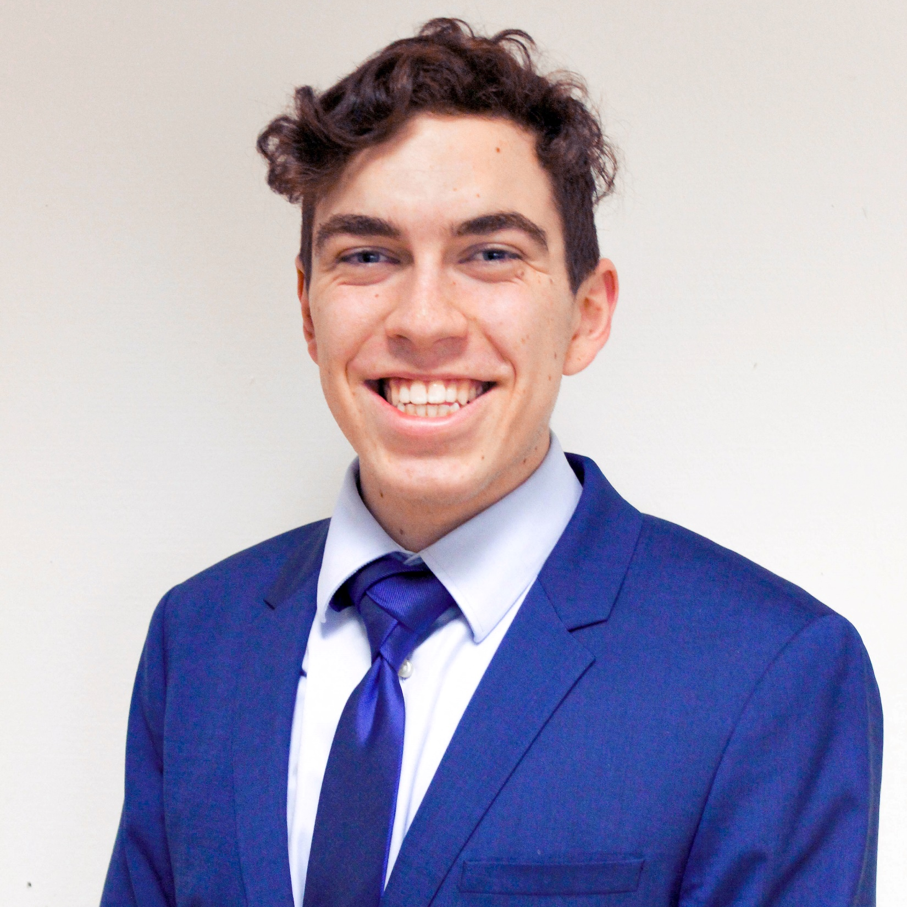

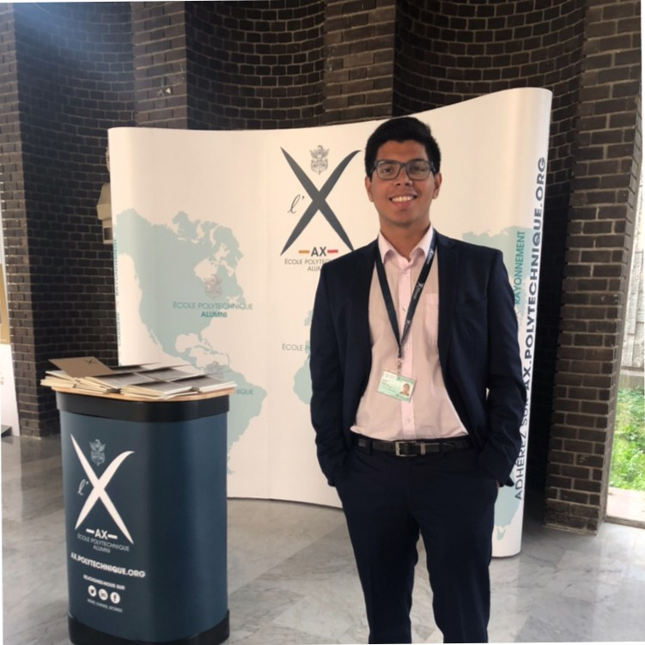
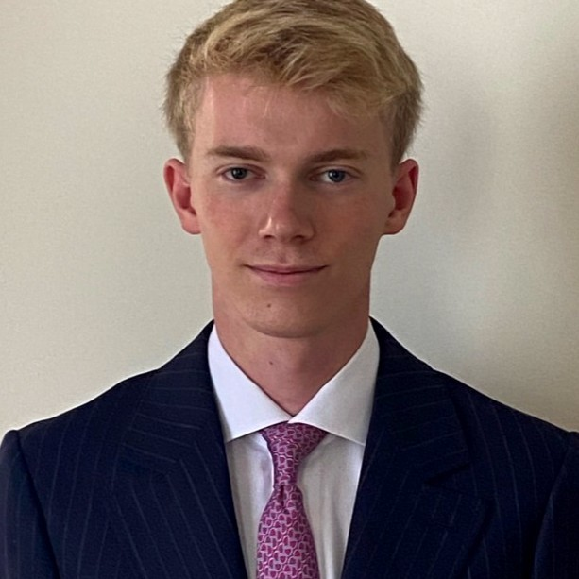


Team & Presenters
Thomas Philipp SCHNEIDER
DSB-Student @X-HEC
thomas-philipp.Schneider@
polytechnique.edu
Shihan YE​
DSB-Student @X-HEC
shihan.ye
@polytechnique.edu
Harshit SHANGARI
DSB-Student @X-HEC
harshit.shangari@polytechnique.edu
Guillaume D'HÉROUVILLE​
DSB-Student @X-HEC
guillaume.dherouville.2022@
polytechnique.edu
Kaan ÇAYLAN
DSB-Student @X-HEC
kaan.caylan@
polytechnique.edu
Rehan Ibrahim AMJAD
DSB-Student @X-HEC
amjad-rehan.ibrahim@
polytechnique.edu

Slide 3

Agenda
Recommendations
Key Performance Indicators
High level roadmap & estimated operational cost
Executive summary
Introduction
Technical Stages

Slide 4
Executive Summary
Objective | Assess the customer relationship strategy of TotalEnergies and provide recommendations for each stage of the customer journey ​
Key Findings | Customer service & price are significant factors for future improvements
Recommendations | Customer Service | Price​
Next Step | Customer services & price improvements KPI evaluation with estimated operational cost
Build an accurate database & give access to customer service​
Hire more customer service agents & train customer service agents
Implement predictive analytics & add notifications, add interactive voice responses and chatbots
Invest more in renewable energy
Provide a more detailed energy consumption report
Communicate with customers about new offers

Slide 5
Agenda
Recommendations
Key Performance Indicators
High level roadmap & estimated operational cost
Executive summary
Introduction
Technical Stages

Slide 6
Problems & Goals
Problems​ | Goals​
Increased competition due to rising energy prices.​ ​ | Analyze the customer feedback using NLP, to identify the key pain points that need to be addressed to improve the customer journey​ ​
Lack of differentiation, risk of increased churn rates due to intensifying competition​ | Provide recommendations to TotalEnergies to help them differentiate themselves and adapt to the increased competition ​ ​

Slide 7
Approaching the Problem
Analyze the position of TotalEnergies in the current market with respect to its competitors
01
Industry Benchmark Analysis
Use NLP to extract and analyze customer feedback, extract main topics and pinpoint pain-points using sentiment analysis
Technical Analysis
02
03
Identify KPIs to measure improvement of pain points and customer journey
Key Performance Indicator
Help TotalEnergies make the data driven decisions based on our analysis
Recommendations
04

Slide 8

Benchmarks
Key benchmarks in the energy industry
Price: Affordability and value offered to customers
Contract duration: Flexibility and commitment towards customers
Customer satisfaction: Quality of service and customer experience
Use of renewable energy: Focus on sustainability and commitment to a greener future
Comprehensive view of TotalEnergies performance helps in understanding TotalEnergies position in the industry.

Slide 9


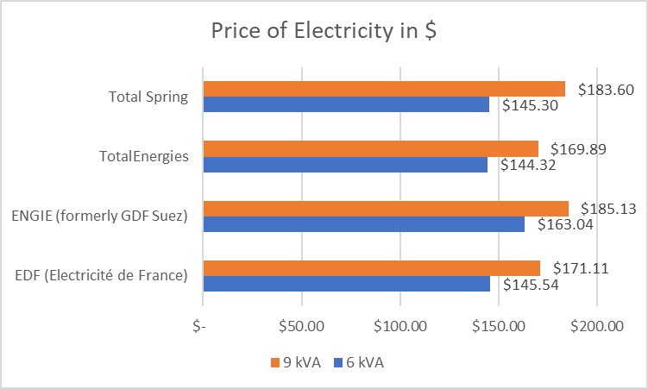
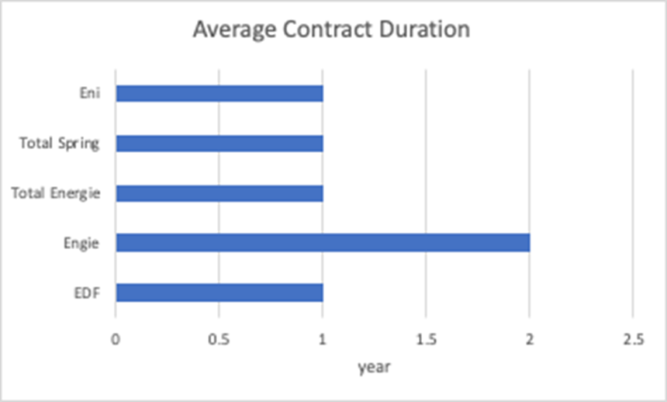


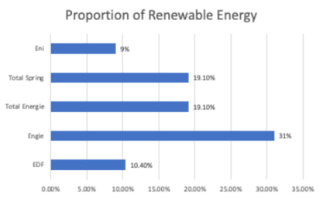
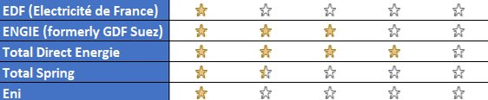
Position

Slide 10
TotalEnergies – Steps and Pain Points
1
Stages
Awareness
Loyalty
Purchase
Evaluation
Consideration
2
Steps
Phones TE
for details of options
Customer Relocates
Research of offers
on Total website
Visits comparison site and review site
Shortlists options based on research
Picks fixed Green or EcoHours;
electricity and/or gas
Agrees to terms and makes purchase
Gets TE app to track
usage
Chooses add-ons
Chooses contract start date
Leaves good review
Contacts customer service
Customer made aware
of better offers
Begins online
form for details of options
3
Touchpoints
Trustpilot/ Hellowatt,
competitor homepage
Homepage or
calls customer service
Homepage or
calls customer service
Writes email or
calls customer service
Campaign website/
TE homepage
TE homepage
Trustpilot/ Hellowatt,
Facebook ad
Downloads TE App
TV ad
Print ad
4
Pain points
“Warning” Ribbon on Total Website
Lower price of competitors,
worse ESG
Info on price & options only after start purchase process
Quality of customer service: Waiting time, multiple calls necessary, no chatbot available, phone reiteration
Price increases, limited consumption report, quality of customer service: not proactive

Slide 11
Agenda
Recommendations
Key Performance Indicators
High level roadmap & estimated operational cost
Executive summary
Introduction
Technical Stages

Slide 12
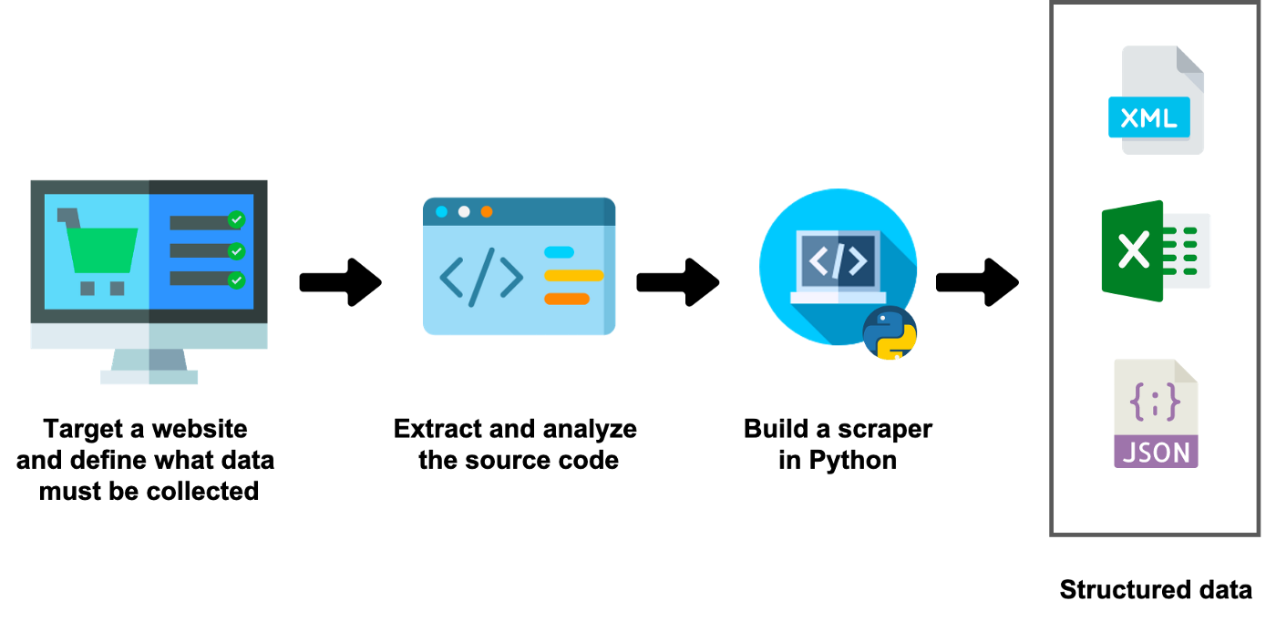


How we obtained data Web scraping
Selenium
Unstructured data

Slide 13
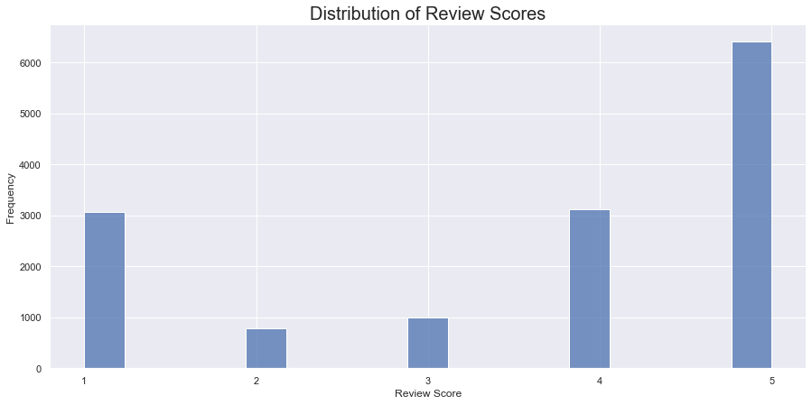
Some Preliminary Insights into Customer Reviews
Over 14000 reviews analyzed
3 Main topics identified and labelled
67% of comments positive with a score above 4 out of 5

Slide 14
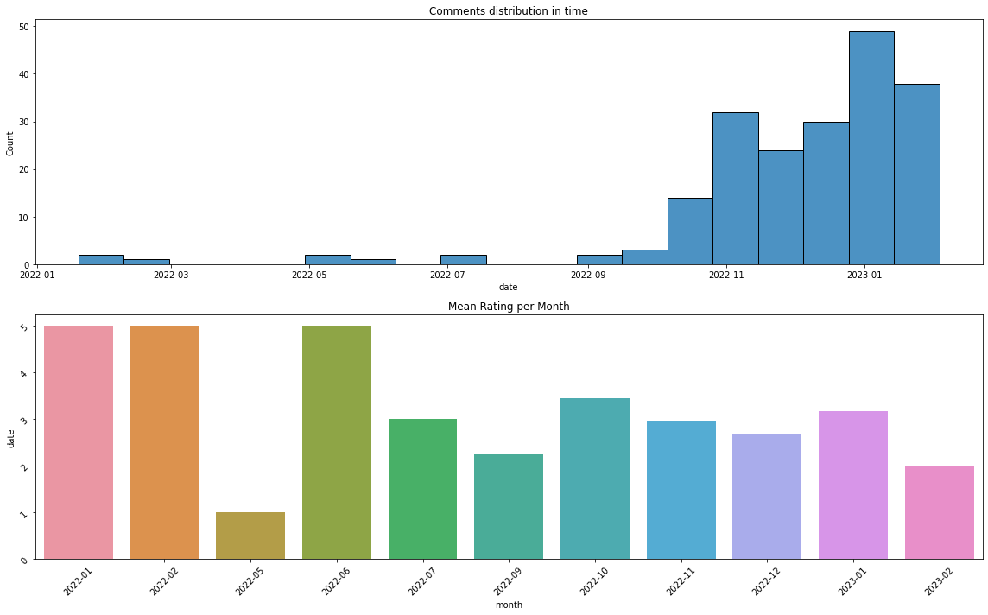
Data Preprocessing & Exploration
Recently, customer feedback is more frequent and there is a downward trend in ratings. Still outperforming peers.
Tokenization
Unigram
Bigram
Cleaning
Lowercase transformation
Removing Punctuation
Removing Letters with accents
Removing Emojis and Whitespace
Orthographic Corrections
Removing Stopwords
Stemming
Lemmatization

Slide 15
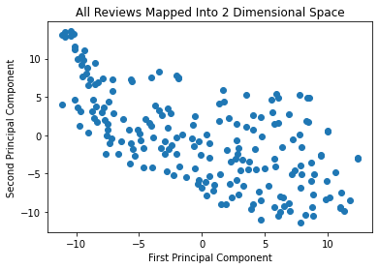
Embedding: Word2Vec
Converting words into numerical vectors of predetermined size to prepare for Topic Extraction and Sentiment Analysis using a single hidden layer neural network approach.
2 possible Approaches:
CBOW: Predicting a target word based on its context words
Skipgram: Predicting context words based on target word

Slide 16
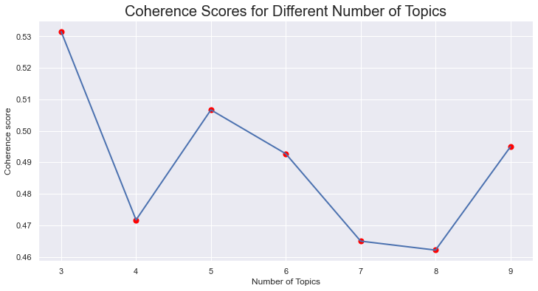
Topic Extraction: Methods
Latent Semantic Indexing
SVD approach to topic extraction
Latent Dirichlet Allocation
Discover hidden topics in the collection of reviews, assign each review a distribution over these topics and assign each topic a distribution over the words in the vocabulary.
Notes:
Coherence score is a way to evaluate the quality of topics generated by LDA (Latent Dirichlet Allocation) model. It measures how coherent the topics are, i.e., how well the words within a topic relate to each other and how distinct the topics are from each other.

Slide 17
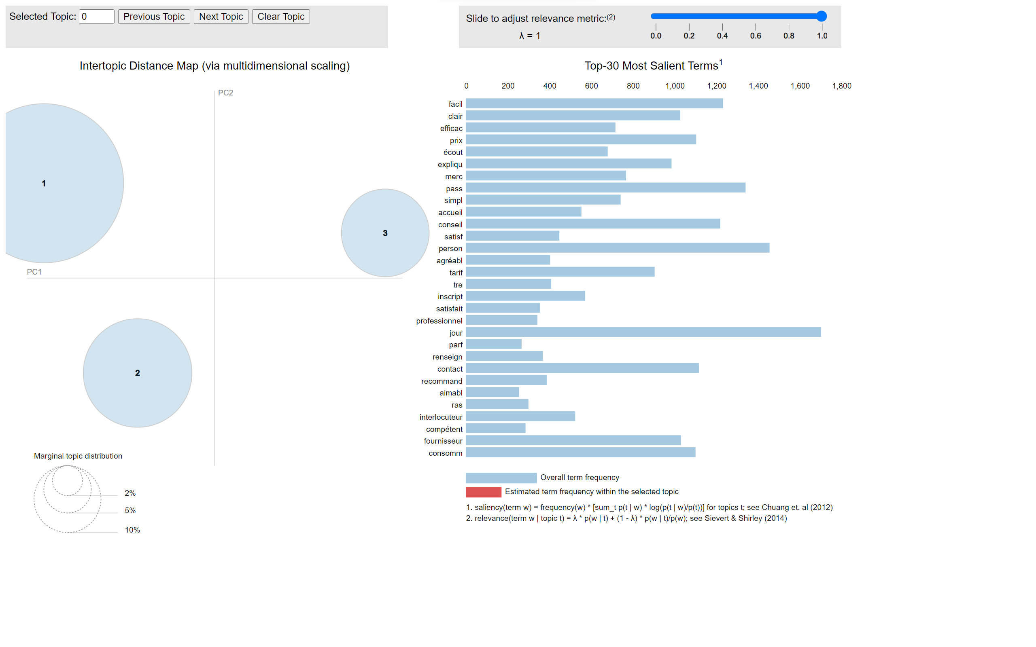
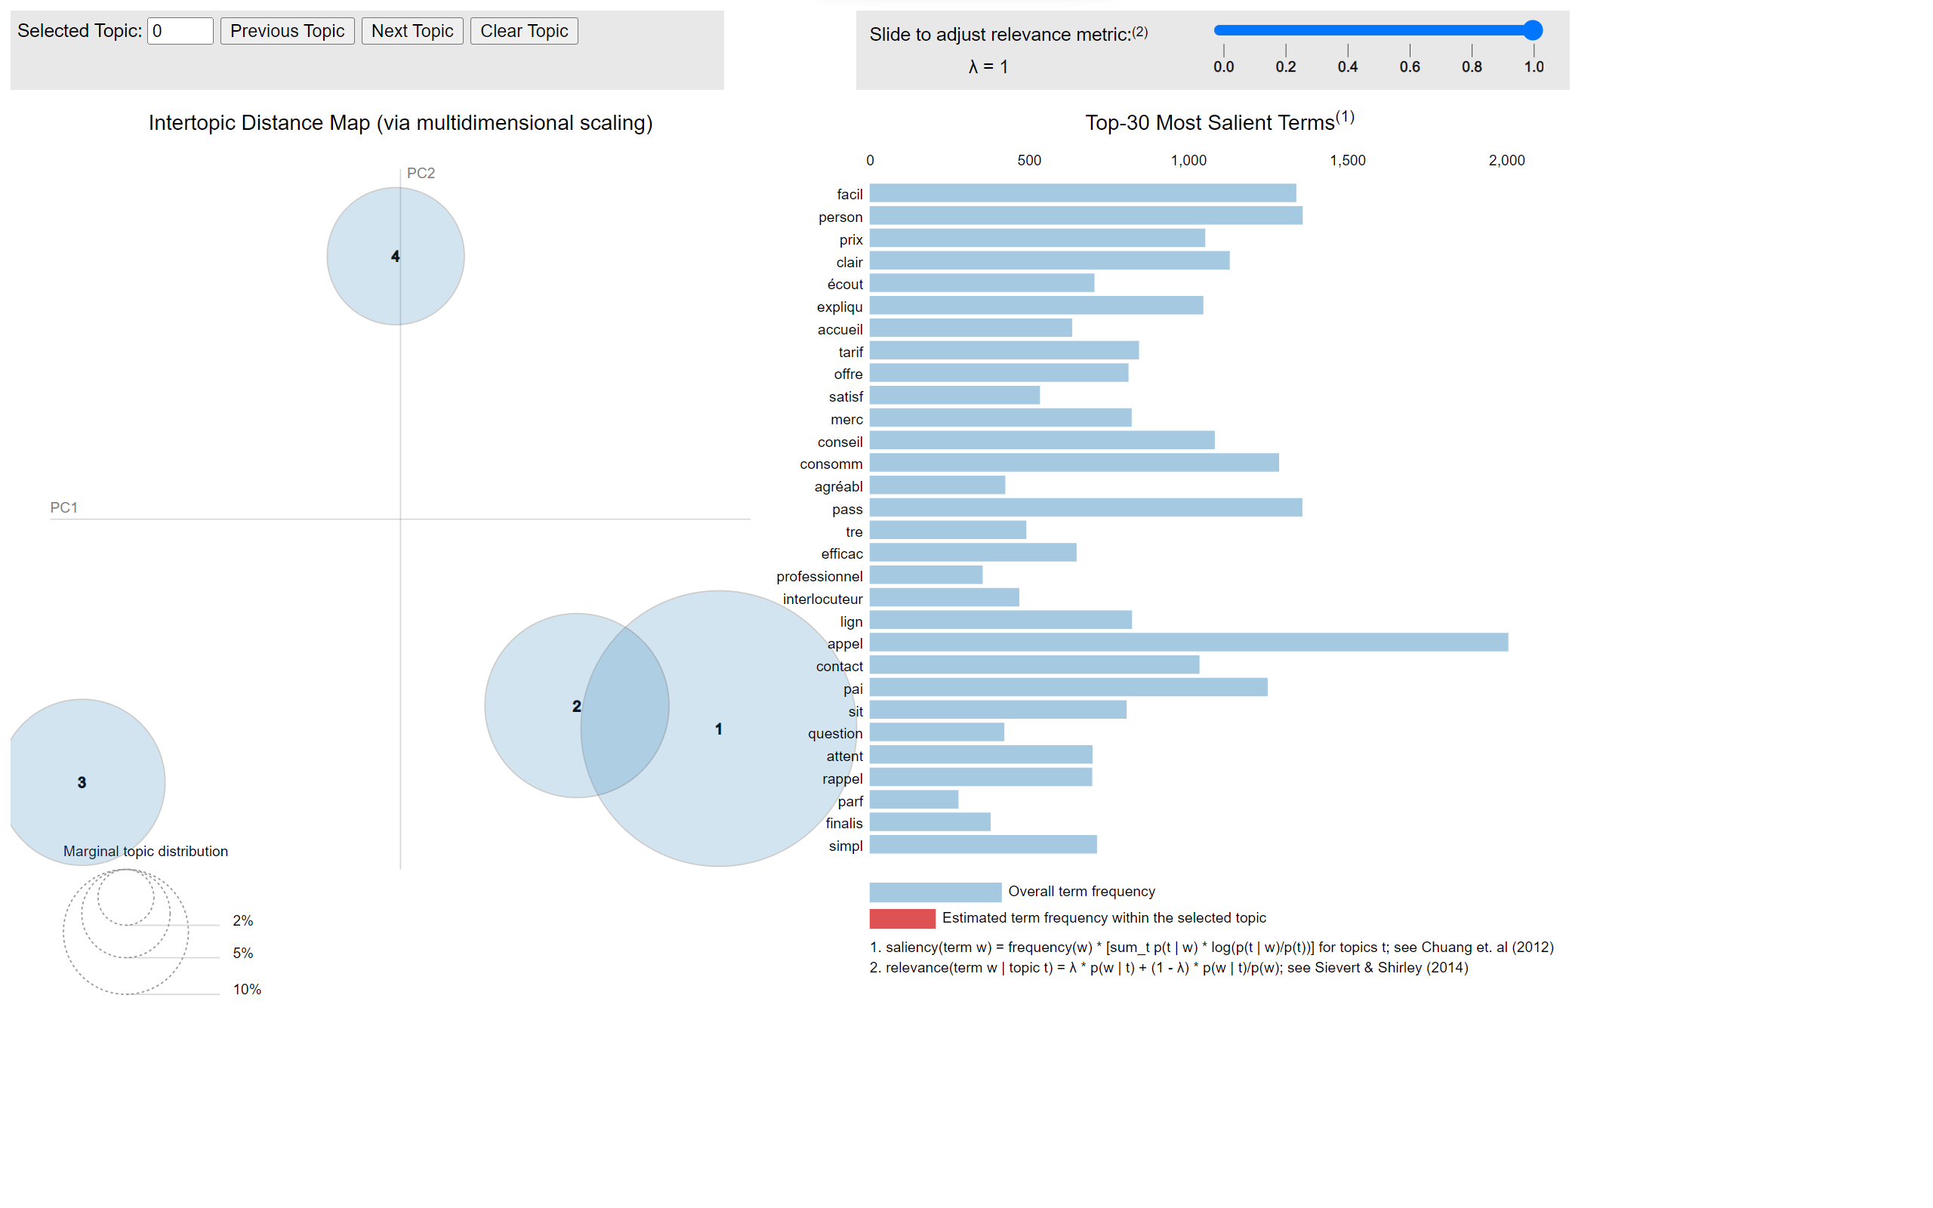
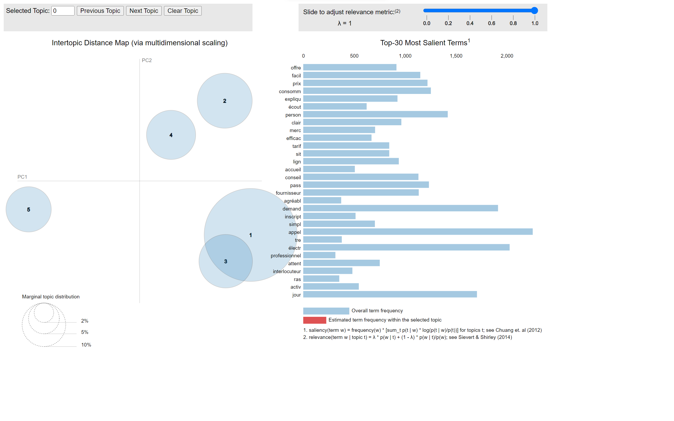
Optimal Number of Topics
3 Topics
4 Topics
5 Topics

Slide 18
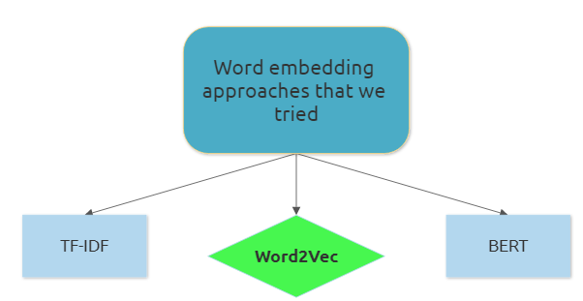
Sentiment Analysis: Methodology
VADER​
TextBlob ​
Rule-based unsupervised approach to sentiment analysis.
Assigns a sentiment score to each word, then aggregates them to get a final sentiment.
Similar to VADER with rule-based and unsupervised approach to sentiment analysis
Specialized for social media tasks
Lexicon-based ​
Both these algorithms have insufficient accuracy due to their vocabulary constraints arising from the lexicon-based approach. Different approaches required!​
VADER
TextBlob
Notes:
Assign a sentiment to each comment. Positive if rating is 4 or 5. Negative rating if rating is less than 4. Ultimate goal is to provide sentiment score for each of the three categories we provided.

Slide 19
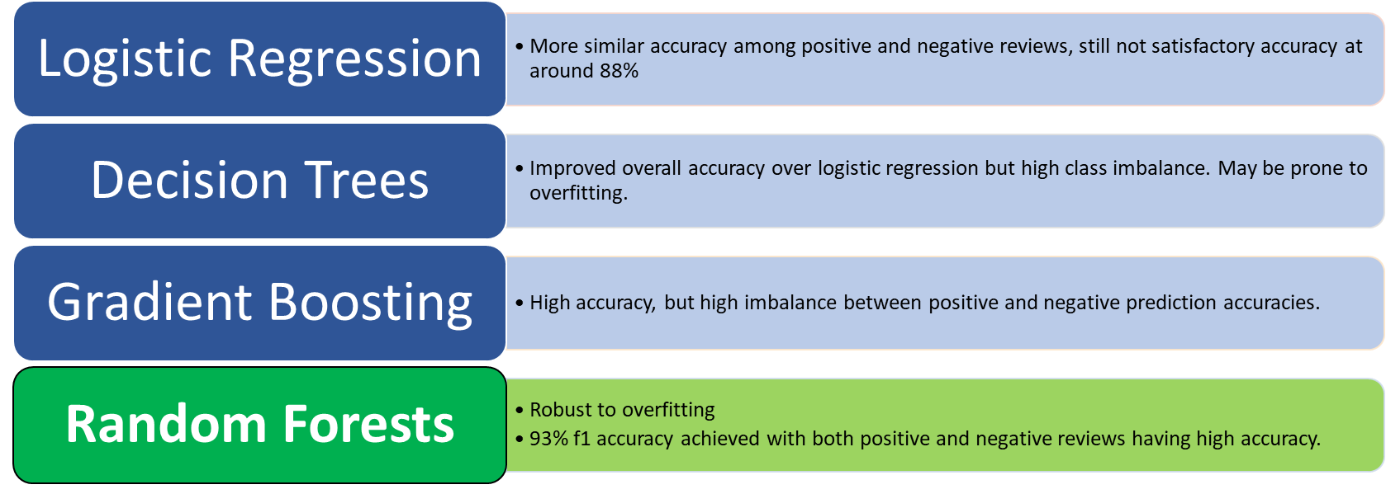
Sentiment Analysis: Methodologies – Supervised Approach
The sentiment analysis predictor may be deployed and used in the future to classify upcoming reviews.

Slide 20
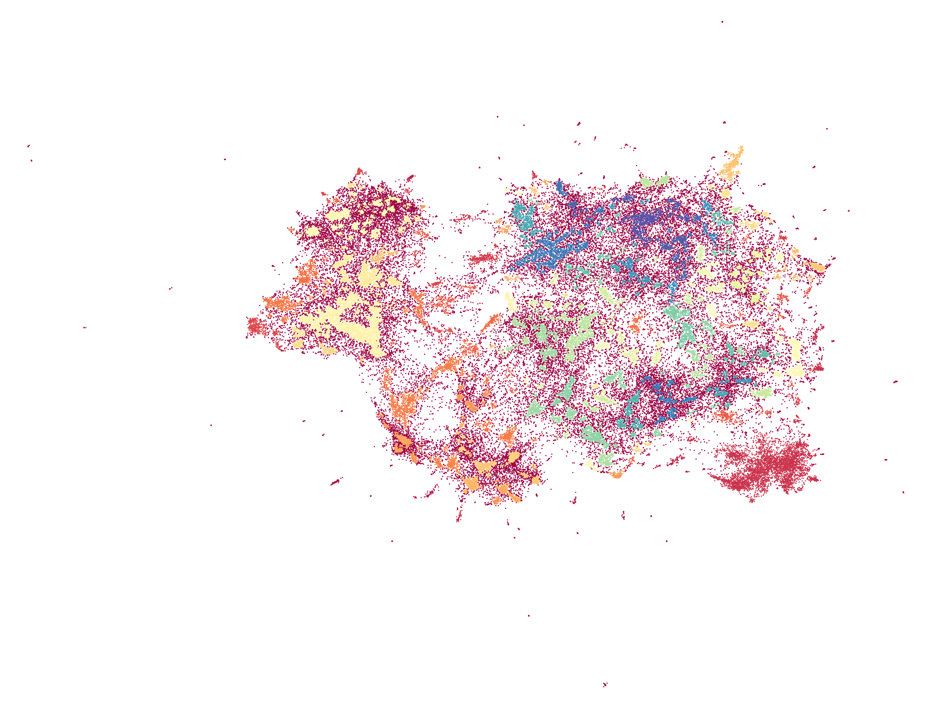
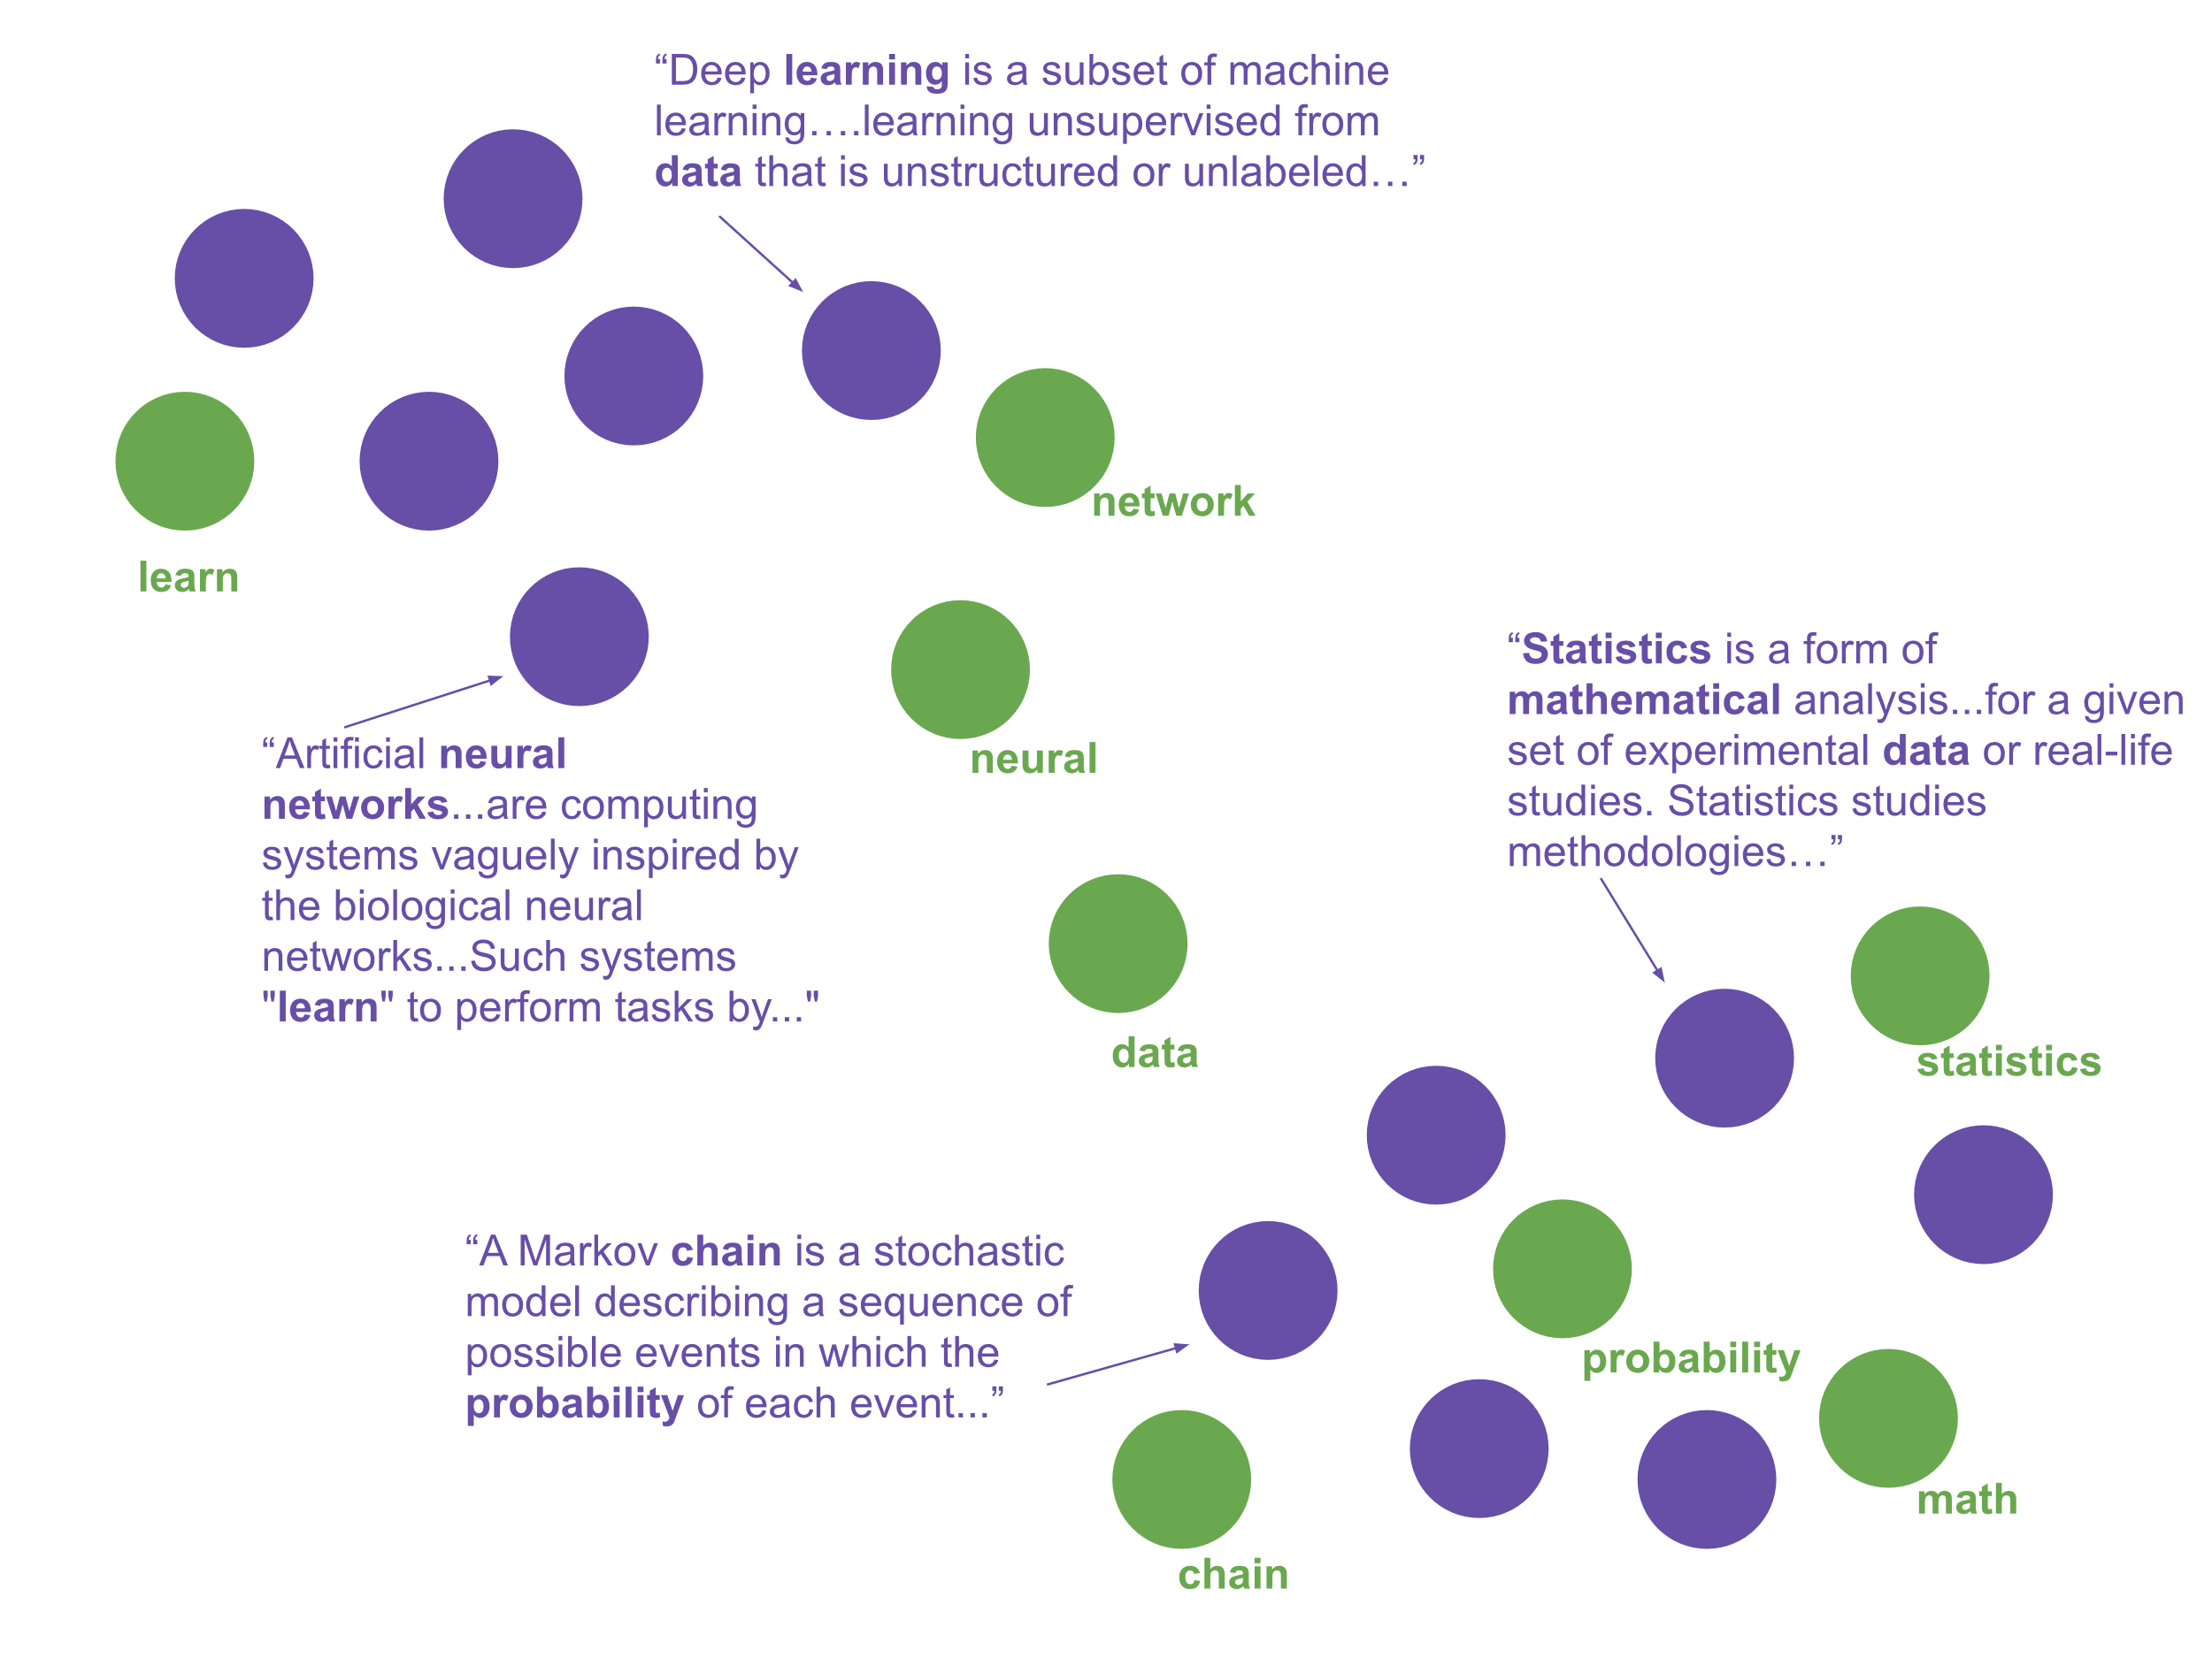

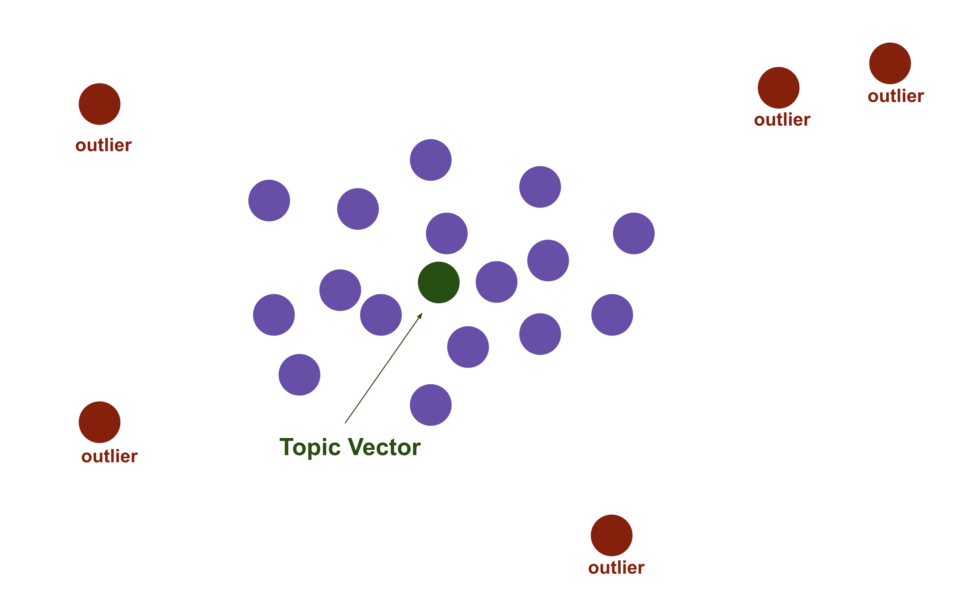
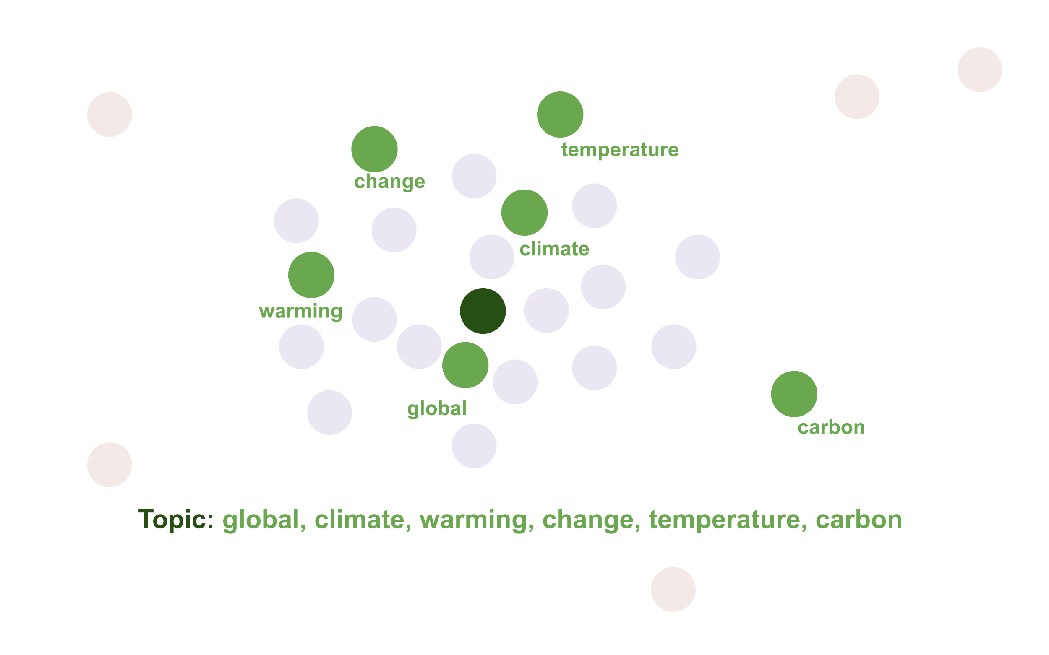
Another Perspective: Top2Vec approach

Slide 21
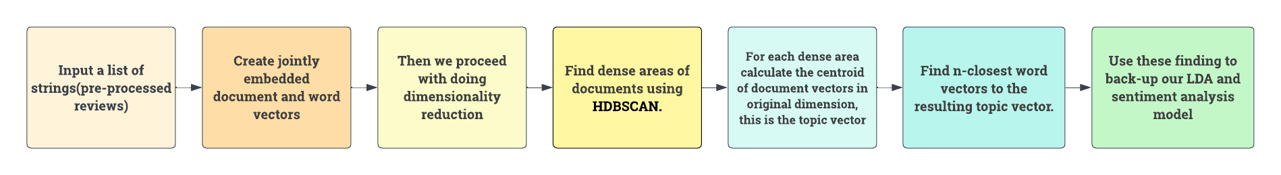
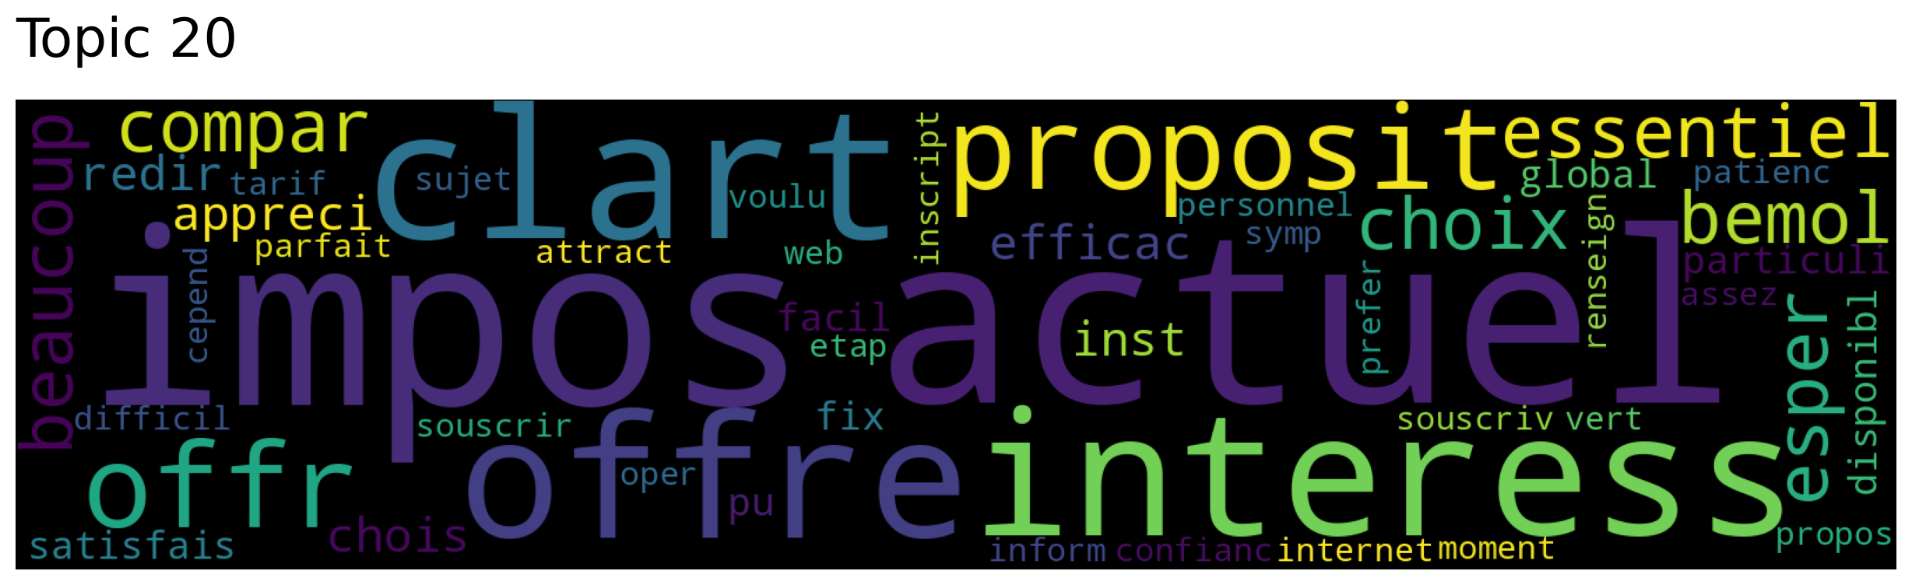
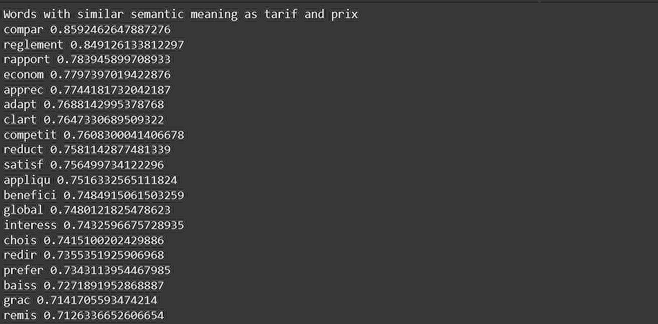
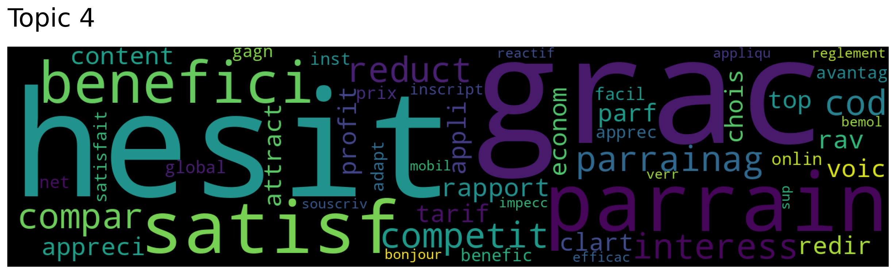
Process Flow and Results

Slide 22
Agenda
Recommendations
Key Performance Indicators
High level roadmap & estimated operational cost
Executive summary
Introduction
Technical Stages

Slide 23
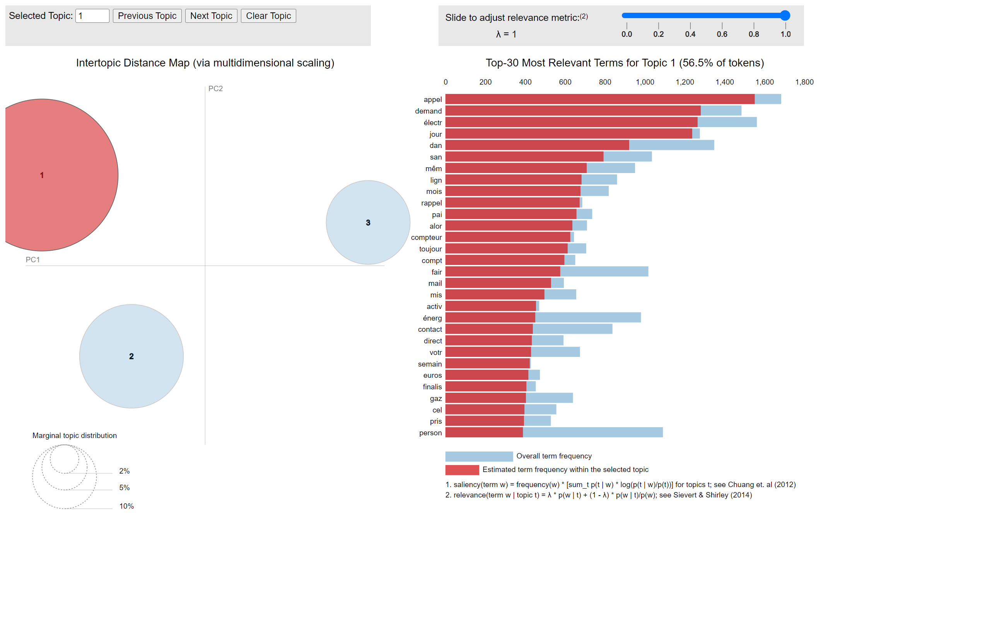
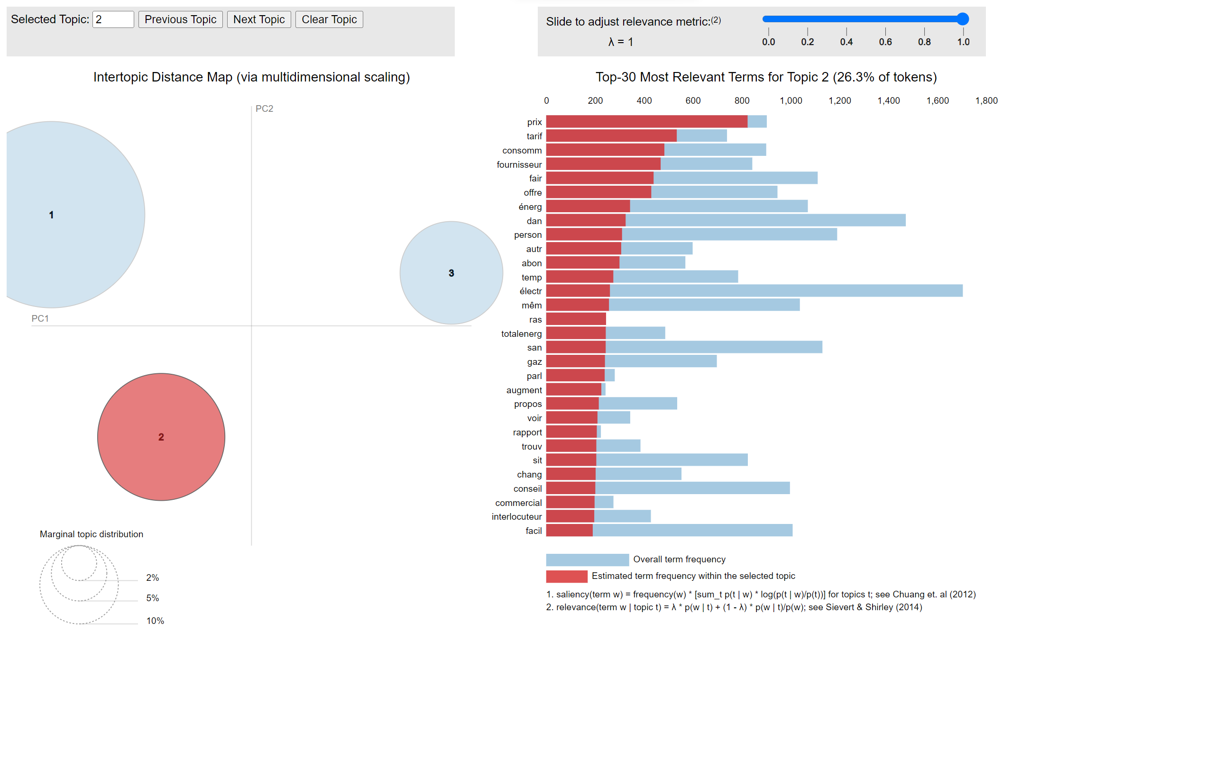
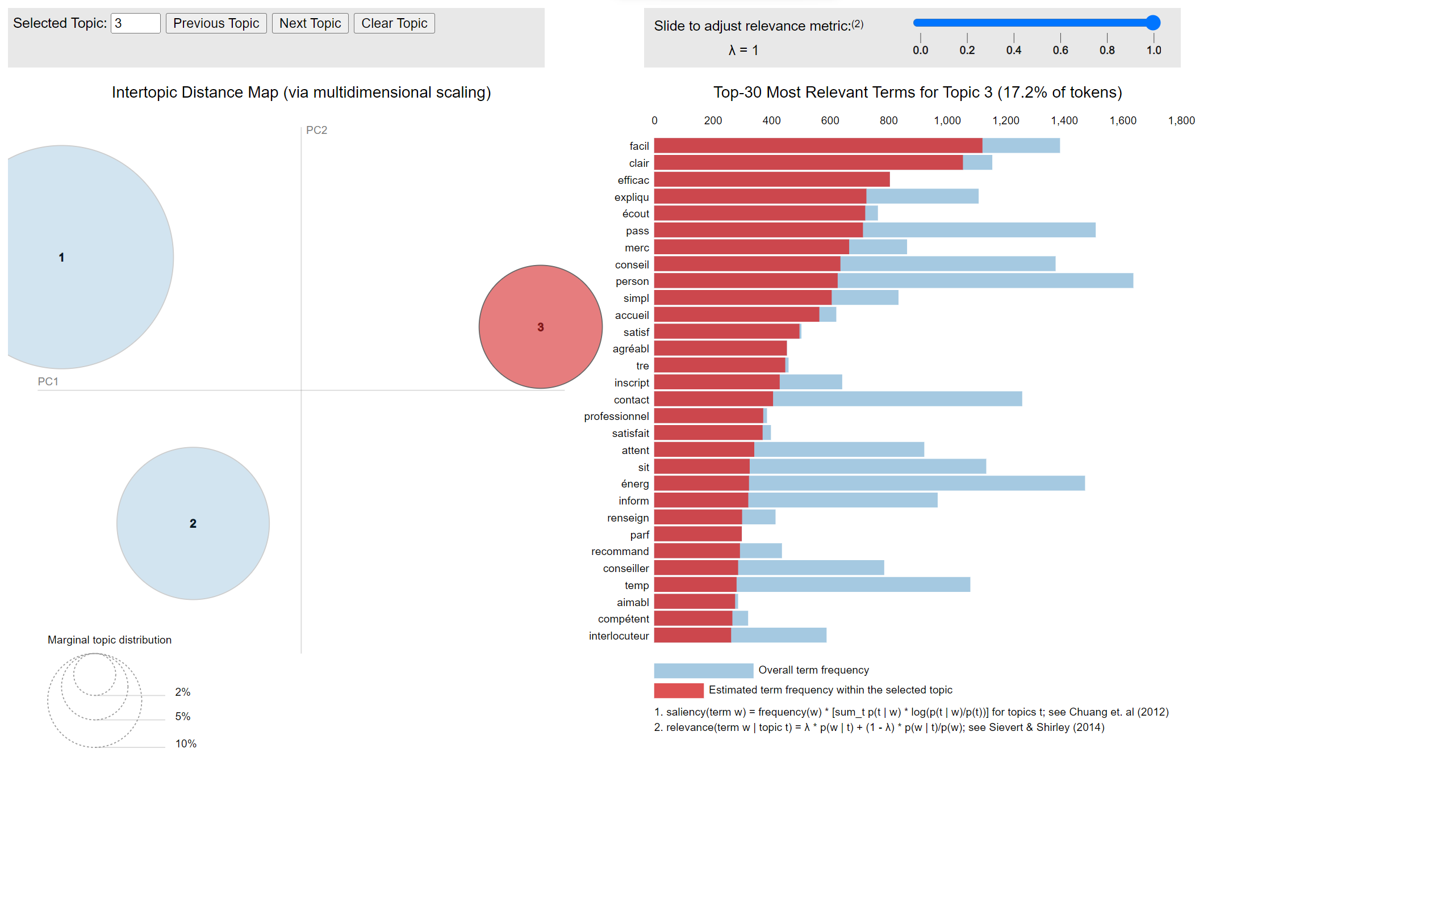
Topic Extraction Results

Slide 24
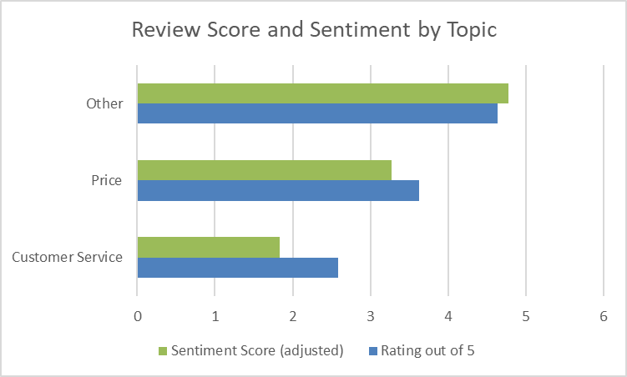
Sentiment Analysis Results

Slide 25
Example Reviews: Customer Service
Problem 1: Online form issues require phone reiteration
Problem 2: Waiting time & multiple calls necessary
Problem 3: Service is not proactive
"The day I moved in, my lines were not activated. The following Monday, I call TotalEnergies again and go through the whole subscription procedure over the phone AGAIN"
After taking the necessary steps via the Internet […] I had to call your services on Thursday morning following an email,[…]. I had to give everything again
"I had to contact customer services four times to sort out the problem"
"it took 3 calls with about 20 minutes waiting time for each (and repeating the same thing each time) "
I phoned and had to wait more than 20 minutes before having a contact person
I feel like I'm being forgotten and that nothing is being done.
I had to contact them about ten times, with a waiting time of more than 5 minutes for each call

Slide 26
Example Reviews: Price
60% increase in the price of gas kwh invoiced in December at the online PRO rate, even though my offer is indexed to the regulated rate (which has not increased by 60%), no response to my complaint and my appeal for 1 month!
"I find that you offer correct prices."
Problem 1: Higher prices
Problem 2: Consumption reports are not detailed
"The amount of future bills is often badly estimated, especially per month, they are not frequent enough and the consumption report is not detailed enough"
"The quality/price ratio seems rather good compared to the competitor."
Disgusted with the tariff that was supposed to be no more than 5% higher than the regulated tariff. A great scam considering your profits.

Slide 27

Top2Vec WordCloud

Slide 28
Recommendations: Customer Service
Online form issues require phone reiteration
Need to store form correctly in database
Give access to Customer Service
Waiting time & multiple calls necessary
Hire more Customer Service Agents
Interactive Voice Response
Chat bots
Service is not proactive
Predictive analytics & notification
Customer Service Training

Slide 29
Recommendations - Price
Surge in energy prices
Invest more in renewable energy
Communicate with customers about new offers
Provide a more detailed energy consumption report

Slide 30
Agenda
Recommendations
Key Performance Indicators
High level roadmap & estimated operational cost
Executive summary
Introduction
Technical Stages

Slide 31



Key Performance Indicators (KPI)
Targets​
Submission error rate
Conversion rate to new offer after communication
Customer lifetime value (CLV)
Marketing revenue attribution
Customer acquisition cost per marketing channel
Traffic-to-lead-rate
Landing page conversion rate
Time spent on website
Customer service waiting times
Lead-to-customer-rate
--> for homepage
--> for customer service
Customer lifetime value (CLV)
First contact resolution
Sentiment score of reviews
Churn Rate
Measurements & Implementations
Single or multi touch attribution models using Hubspot
Calculating total Costs incurred, CAC can be calculated through tools like Salesforce/in-built tools in GoogleAds
Define a lead (person who fills a form), Track the number of visitors and leads
Implement marketing automation software (such as Pardot) to track time spent
Avg. number of minutes to reach customer service
Sentiment Score calculated using NLP
Define a lead (person who fills a form), Track the number of visitors and leads
Implement marketing automation software (such as Pardot) to track time spent
Feasibility
Difficult to implement, software are expensive
Easy to implement with software relatively cheap
Easy to implement, need to collect data about waiting times
SER and CRAC are easy to implement
CLV is hard to implement and costly
Easy to implement
Define a lead (person
Notes:
Single or multi touch attribution models using Hubspot
Calculating total Costs incurred and total number of customers acquired, CAC can be calculated through tools like Salesforce/in-built tools in GoogleAds
implement marketing automation software (such as Marketo or Pardot) to track time spent

Slide 32
Agenda
Recommendations
Key Performance Indicators
High level roadmap & estimated operational cost
Executive summary
Introduction
Technical Stages

Slide 33


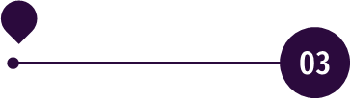
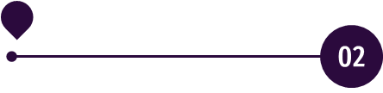
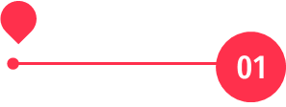
Next steps : Roadmap
KPI evaluation :
Assess the efficiency of the implementation
Repeat from Step 1
Customer service improvement :
#1 More staffing to reduce waiting time
#2 CS training to be more proactive
#3 Implement a chatbot on the website
Price improvement :
#1 More detailed energy report
Current stage :
Identify KPIs we want to improve
Choose next steps accordingly

Slide 34
Cost of Implementation
Recommendation
Customer Service
Customer Service
Customer Service
Price
Actions
More staffing to reduce waiting time
CS training to be more proactive​
Implement a chatbot on the website
More detailed energy report​s
Cost estimation
Hire more CS staff : 42k/year considering a gross salary of 30k/year
10% increase
Total : Hires*42k/year
Mandatory training for all CS employees, twice a year, on CRM best practices
Reimbursed by OPCA
Total : Insignificant
Outsourcing
Advanced Q&A software: 10-15k
Can be improved later (i. e. include payment)
Total : 10k (basic version)
Assign a data engineer to the task
65k/year = 30€/h (45h/week)
35h needed
Total : 1050€ + follow-up

Slide 35
References
Renewable Energy
https://www.edf.fr/en/the-edf-group/producing-a-climate-friendly-energy#:~:text=In%20France%2C%20the%20electricity%20produced,nuclear%20power%20and%20renewable%20energies.
https://www.engie.com/sites/default/files/assets/documents/2021-09/ENGIE-ChiffresCle2021-EN-WEB_0.pdf
Contract Duration
https://www.edfenergy.com/sme-business/customer/renewals
https://particuliers.engie.fr/aide-contact/questions-reponses/mon-espace-client/contrat/contrat-se-termine-quand.html
https://en.selectra.info/energy-france/suppliers/total-direct-energie
Customer Service
https://fr.trustpilot.com/review/totalenergies.fr
https://fr.trustpilot.com/review/engie.fr
https://fr.trustpilot.com/review/edf.fr
https://fr.trustpilot.com/review/total-spring.fr
https://fr.trustpilot.com/review/eni.fr
Price Comparison
•https://www.fournisseurs-electricite.com/en/edf
https://www.fournisseurs-electricite.com/en/engie

Slide 36
Thank you! WE ARE OPEN TO QUESTIONS
Master X-HEC – 23.01.2023 © Capgemini 2023. All rights reserved | 1

